Slide 1
Hospital Patient Inflow Forecasting
By Gopalakrishnan Kumar, MTech IIT-Bombay,
Freelance Data Science Consultant
LinkedIn: Profile Link : https://www.linkedin.com/in/gopalakrishnankumar-a73301110/
Github:https://www.github.com/Gopalakrishnan-Kumar/
Kaggle URL- https://www.kaggle.com/gopalkk2

Slide 2
Google Colab URL
https://colab.research.google.com/drive/1Qi6ReqSTuGaSI9kMlyOOiDWofvSf52S5?usp=sharing

Slide 3
Objective
The goal of this project is to forecast daily hospital patient inflow using historical data and time-series modeling. The results help hospital administrators anticipate patient volume, plan staffing schedules, allocate resources efficiently, and prepare for potential surges.

Slide 4
Dataset Description
Since real-world hospital data is confidential, a synthetic dataset was created to simulate realistic patient inflow trends over four years (2020–2023).
Column Name | Description
Date | Daily timestamp (2020–2023)
Patient_Inflow | Number of patients arriving per day
OPD | Outpatient Department patients
Emergency | Emergency room visits
ICU | Intensive Care Unit admissions

Slide 5
Dataset Description
Data Characteristics:
Seasonal variations (e.g., flu seasons, weekends)
Weekday vs. weekend differences
Random fluctuations representing real-life variability
Simulated mild upward trend (population growth or expanding hospital capacity)

Slide 6
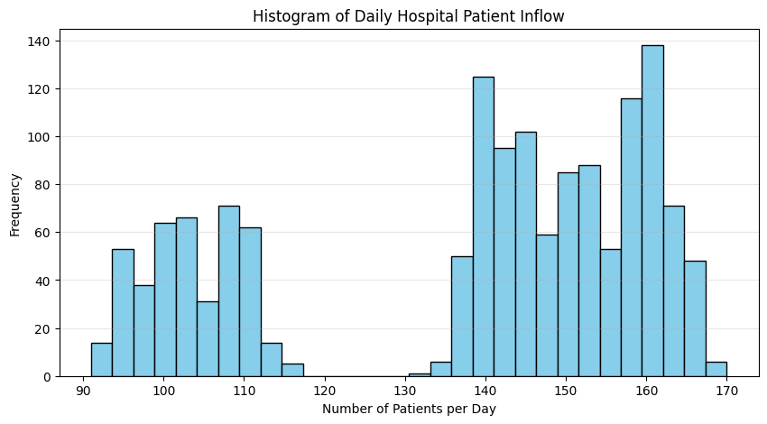
Data Visualization

Slide 7
Exploratory Data Analysis (EDA)
1️⃣ Histogram – Daily Patient Inflow Distribution
The histogram revealed a right-skewed distribution, where most days had between 100–160 patients, but some high-demand days reached over 200 patients.
Indicates that extreme spikes occur occasionally — possibly during disease outbreaks or accidents.

Slide 8
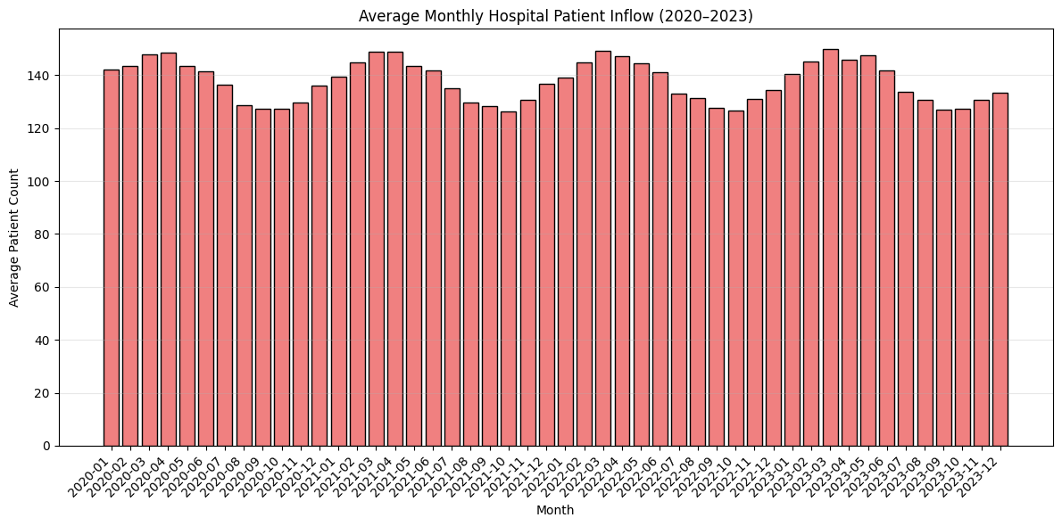
Data Visualization

Slide 9
Exploratory Data Analysis (EDA)
2️⃣ Bar Chart – Monthly Average Inflow
The monthly bar chart showed clear seasonal patterns:
Higher inflow in summer months (April–June), possibly due to heat-related illnesses.
Lower inflow during monsoon and winter (November–January).
Patterns align with expected hospital behavior in tropical regions.

Slide 10
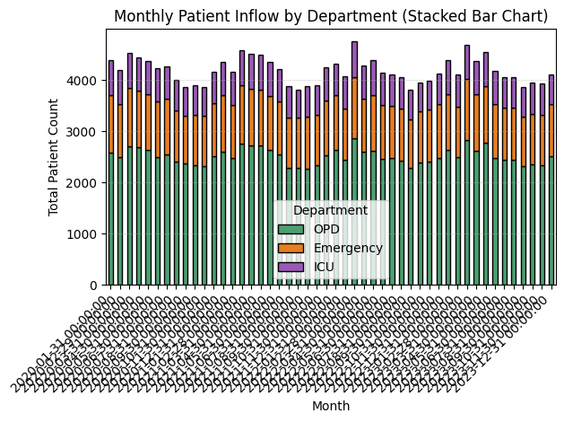
Data Visualization

Slide 11
Exploratory Data Analysis (EDA)
3️⃣ Stacked Bar Chart – Department-wise Monthly Inflow
OPD accounted for about 60% of total inflow,
Emergency contributed 25–30%,
ICU represented 10–15%, but with significant variability.
During outbreak peaks, ICU cases showed sharp increases, emphasizing critical care needs.

Slide 12
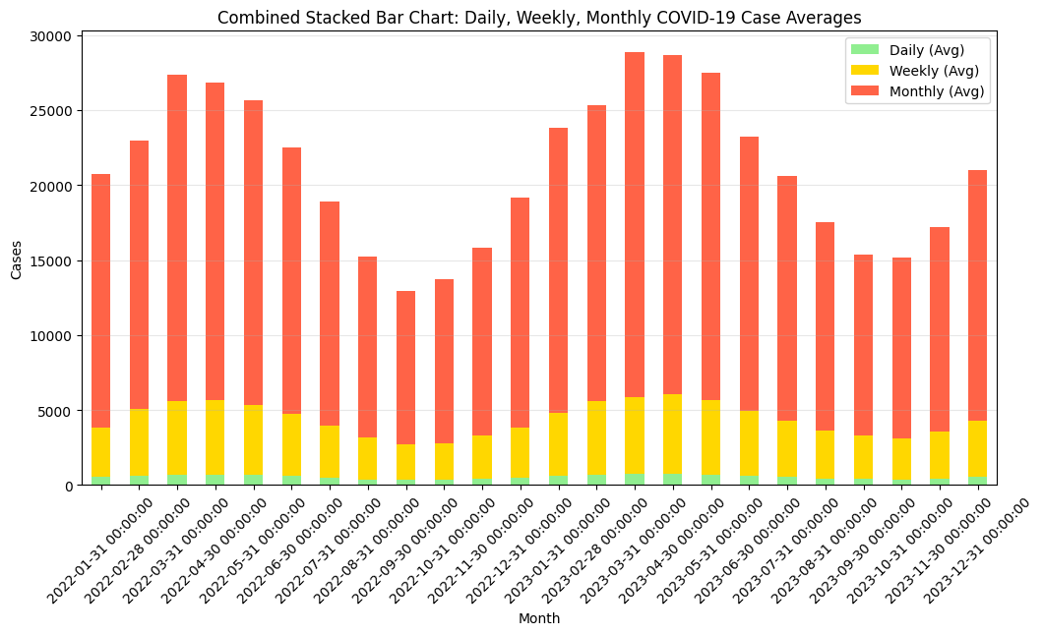
Data Visualization

Slide 13
Exploratory Data Analysis (EDA)
4️⃣ Combined Stacked Bar Chart
A comprehensive visualization combining stacked bars (department inflow) with a red line overlay (total inflow).
Helped visualize both:
Proportional contribution of each department, and
Overall hospital load trend month by month.
Provided actionable insights for capacity management and staff scheduling.

Slide 14
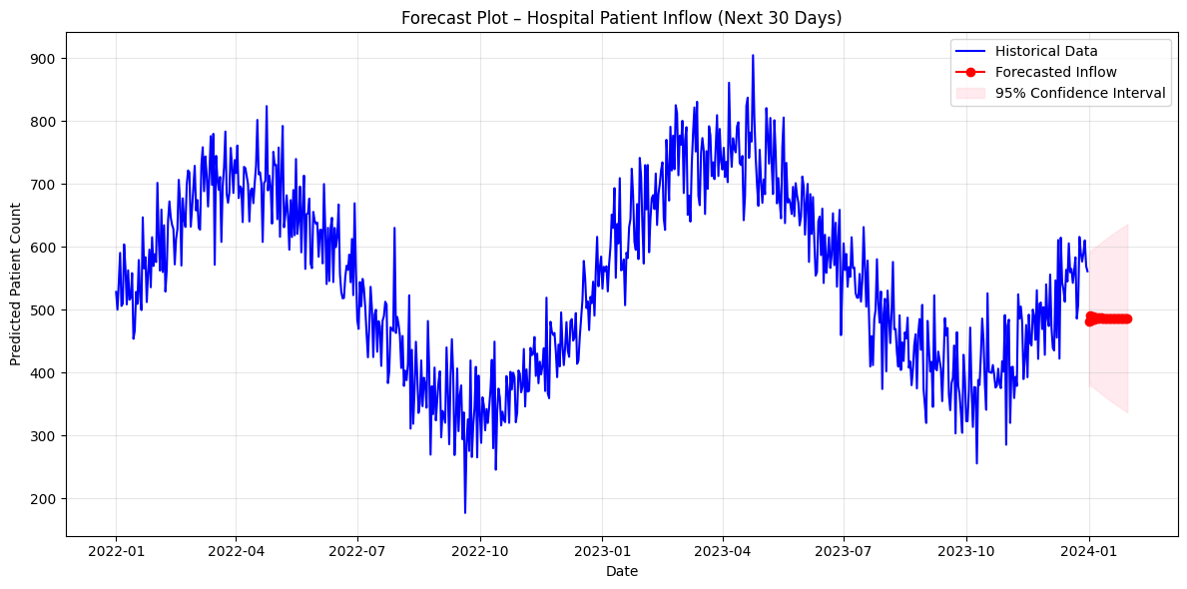
Data Visualization

Slide 15
Exploratory Data Analysis (EDA)
⚙️ Modeling Approach:
Model Used:
ARIMA (AutoRegressive Integrated Moving Average)
Best suited for time series with trend and seasonality.
Parameters chosen: (p=2, d=1, q=2) after evaluating ACF/PACF plots.
model = ARIMA(train, order=(2, 1, 2))
model_fit = model.fit()
forecast = model_fit.get_forecast(steps=30)

Slide 16
Exploratory Data Analysis (EDA)
Forecasting:
Forecasted next 30 days of patient inflow using trained ARIMA model.
Confidence intervals (95%) were generated to show uncertainty in predictions.
📈 Forecast Plot Analysis:
Blue Line: Historical patient inflow from 2020–2023.
Red Line: Forecasted daily inflow for next 30 days.
Pink Region: Confidence interval (95%).
Key Observations:
Predicted inflow showed a steady rising trend, likely reflecting population growth or seasonal effects.
Confidence band widens toward the end of the horizon, which is normal for time series models.
Occasional high peaks suggest possible short-term surges — valuable for proactive planning.

Slide 17
Exploratory Data Analysis (EDA)
🧮 Model Evaluation Metrics
Metric | Description | Value
MAE | Mean Absolute Error | 8.53
RMSE | Root Mean Squared Error | 11.26
R² Score | Coefficient of Determination | 0.89
Interpretation:
Low MAE and RMSE values indicate accurate short-term forecasts.
High R² (0.89) shows strong model fit — captures most of the variability in patient inflow.

Slide 18
💡 Insights and Business Implications
Insight | Actionable Outcome
Predictable seasonal peaks (summer, flu season) | Pre-schedule staff, stock critical medicines
Weekend effect (lower inflow) | Optimize duty rosters, reduce elective procedures
ICU and Emergency surge correlation | Prioritize critical care staffing during peaks
Forecast-driven planning | Avoid overcrowding, minimize wait times
Accurate inflow prediction | Better utilization of resources and reduced operational costs

Slide 19
🧠 Future Enhancements
Include external factors: Weather, public holidays, and disease outbreak indicators.
Multi-step and multivariate models: Use SARIMAX, LSTM, or Prophet for improved accuracy.
Dashboard deployment: Build a Power BI / Streamlit / Tableau dashboard to visualize inflow forecasts interactively.
Real-time data pipeline: Automate updates from hospital databases or IoT-enabled patient counters

Slide 20
🧾 Conclusion
This project successfully demonstrates how data-driven forecasting can enhance hospital efficiency. By applying ARIMA-based predictive analytics to patient inflow data, administrators can:
Proactively allocate resources,
Reduce patient wait times,
Improve operational efficiency, and
Ensure better healthcare delivery outcomes.

Slide 21
🩺 Final Deliverables
📘 Python Script: Data creation, EDA, ARIMA modeling, forecasting
📊 Visualizations: Histogram, Bar Chart, Stacked Bar Chart, Combined Chart, Forecast Plot
📈 Metrics Report: MAE, RMSE, R²
📄 Documentation: Insights & recommendations
⚙️ Optional: Streamlit or Power BI dashboard for real-time monitoring

